Slide 1

Chapter 6
Employee Benefits

Slide 2
Go to Google Classroom and Complete the Ed Puzzle: Employee Benefits
Must be completed this hour.

Slide 3
Optional Employee Benefits

Slide 4
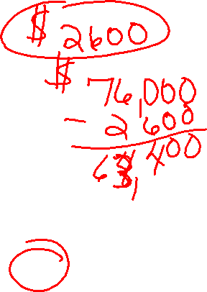
Health Insurance 5 Key Facts
4 Types: May offer medical, dental, vision or life insurance–separate packages
Employers can pay all or some of monthly premium.
  Ex: Can cost $600 or more a month, employer pays $500, you pay $100
  Normally 50% or more paid by employer
Taken out pretax
Can be for just the employee, or for employee plus family
May have deductibles and copays:
  Copay - is a fixed amount a healthcare beneficiary pays for covered medical services before each appointment ($25.00)
  Deductibles – amount you must pay out of pocket before the plan covers any expenses. ($250)
  Coverage pays for a percentage of your bill. Ex: 80%

Slide 5
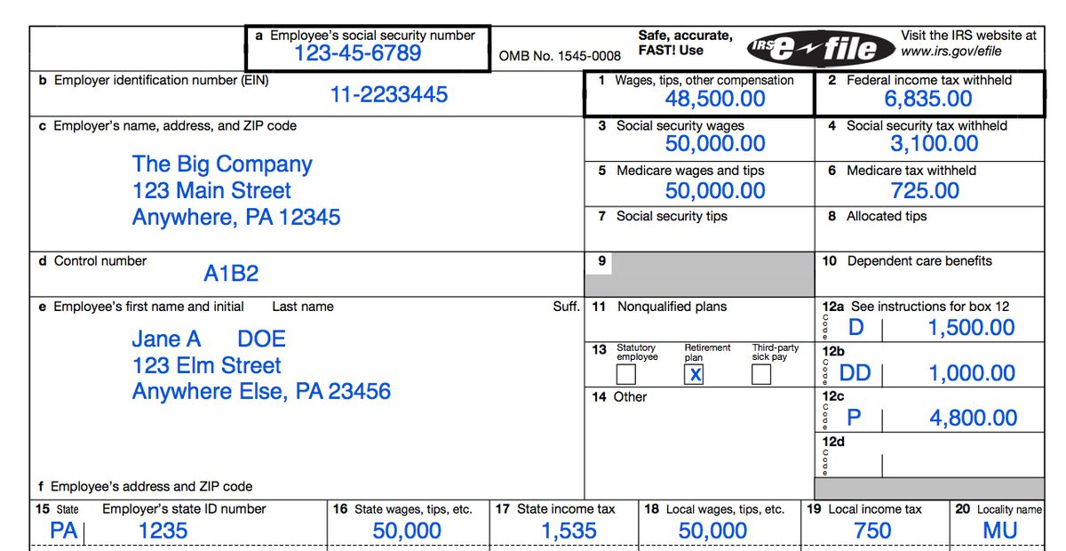

Box 3 = your gross wage
Box 1 = your taxable gross wage
- retirement funds like 401k, IRAs, medical premiums, flexible spending accounts and other deductions can reduce your taxable income

Slide 6
Types of Leave

Slide 7

4 Types of Leave Benefits
Types of Paid Leave Benefits
  Holiday Pay
  Vacation Pay
  Sick Pay
  Bereavement

Slide 8

Holiday Pay
  Holiday Pay = is a gift to employees so they can take time off without losing wages on legal holidays
  Hourly Employees:
    Not required to pay you on a legal holiday
    If however, you work a holiday, it is required to be paid, however, it doesn’t have to exceed the employees’ normal pay rate
    Sometimes, employers give (gift) 2 X hourly pay or 1.5 X hourly pay if an employee works on a holiday, not required by law.
  Salaried Employees
    Paid the full weekly salary, can’t reduce their salary for a holiday
    Don’t have to pay extra if work on a holiday

Slide 9
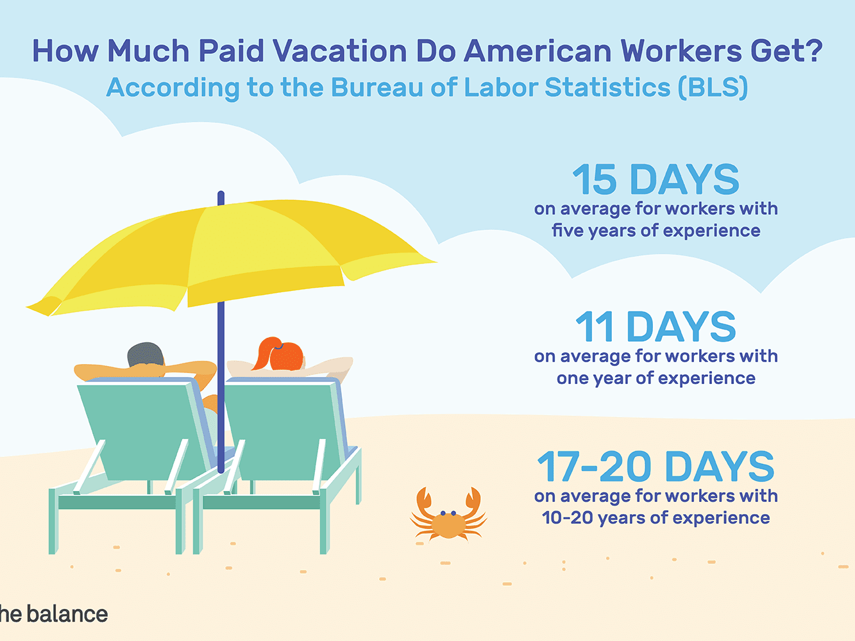
Vacation Pay
  Vacation Pay = earn your regular wage while on vacation
    Employers are not required to provide vacation time
    Companies offer vacation to be competitive in recruiting, increase employee morale and minimize turnover rates.
    Offered to full-time but not part time workers
    Average = 11 hours per week
    Often earn more hours
    the longer you work there
    When you quit, you
    may get paid for unused
    time

Slide 10

Sick Pay
Sick Pay = paid regular wage when you miss work due to illness
    employer optional and employer defined
    Ex: 6 days a year, 4 hours a month, or 1 day per month
    When you quit, you do not get paid for unused hours

Slide 11
  Bereavement – several days, usually up to 5 a year, for the death of an immediate family member
    such as spouse, parent, or child
    Sometime an aunt or uncle
    Number of days is based on relationship. Ex: 1 day for an aunt, 5 days for a spouse
    Does not reduce your vacation or sick time

Slide 12

PTO Pay
  PTO – Paid Time off provides a bank of hours in which the employer pools sick days, vacation days, and personal days all in one.
  Allows employees to use as the need or desire arises
  One bank of hours for all types of pay except holiday
  Usually can not carry over at the end of the year
  If you don’t use it, you lose it

Slide 13
Retirement benefits

Slide 14
Assignment
Access the Types of Retirement Accounts assignment in Google Classroom.
Research the four types of Retirement accounts – 2 Are offered by employers, 2 you could do on your own

